Slide 1
Stay Fit
By ,
Prashant Gohel
Sarju Hansaliya

Slide 2
Introduction
Fitness Tracking App
Single user
Requirements
BLE enabled iphone (4s or later)
BLE HRM
Ios (6.0 and later)

Slide 3
Features
Stay Fit is charged with the responsibility of being helpful in being fit by including following activities.
HR Monitor Connection
Set Workout Goals
Set Workout Reminder
Undergo Workout
Workout Report
Music Player
Voice Assistance

Slide 4
Use cases
User Profile
Connection Manager
Workout Goals
Workout
Workout Report
Statistics
HR Monitor
Workout Reminder
Reset All

Slide 5
Use cases
User Profile
Set User Profile
Edit User Profile
Connection Manager
Workout Goals
Workout
Workout Report
Statistics
HR Monitor
Workout Reminder
Reset All

Slide 6
Set User profile

Slide 7
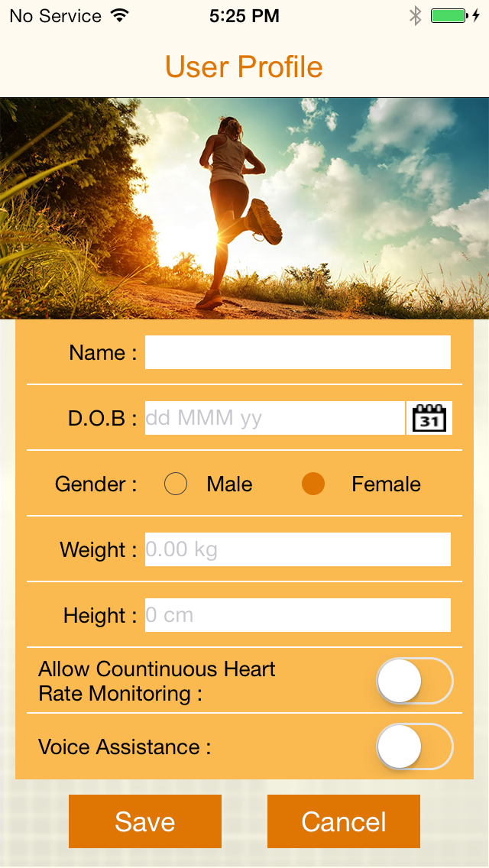
Set User Profile 1

Slide 8
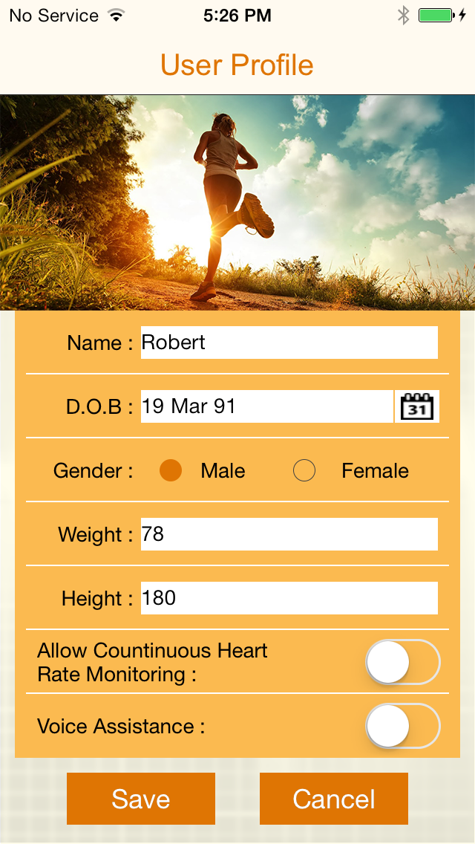
Set User Profile 2

Slide 9
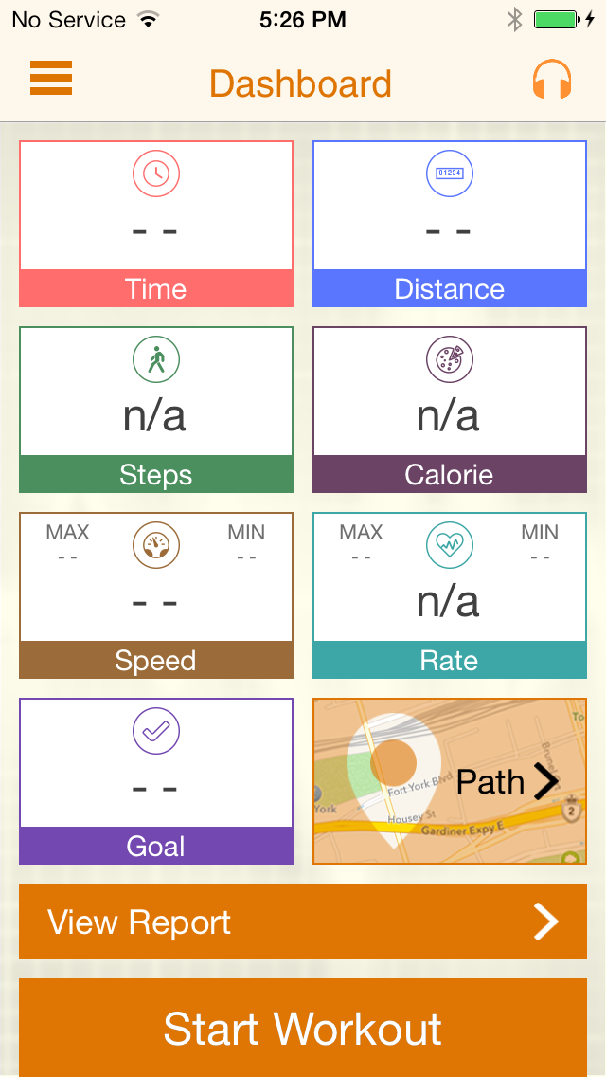
Set User Profile 3

Slide 10
Edit User profile

Slide 11
Edit User Profile 1

Slide 12
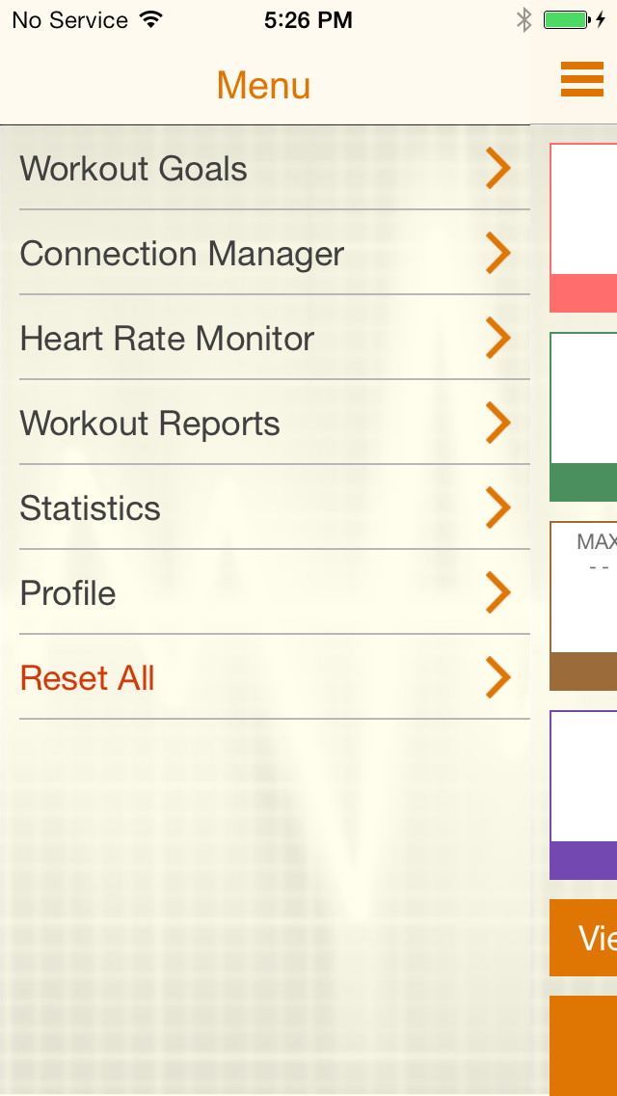
Edit User Profile 2

Slide 13
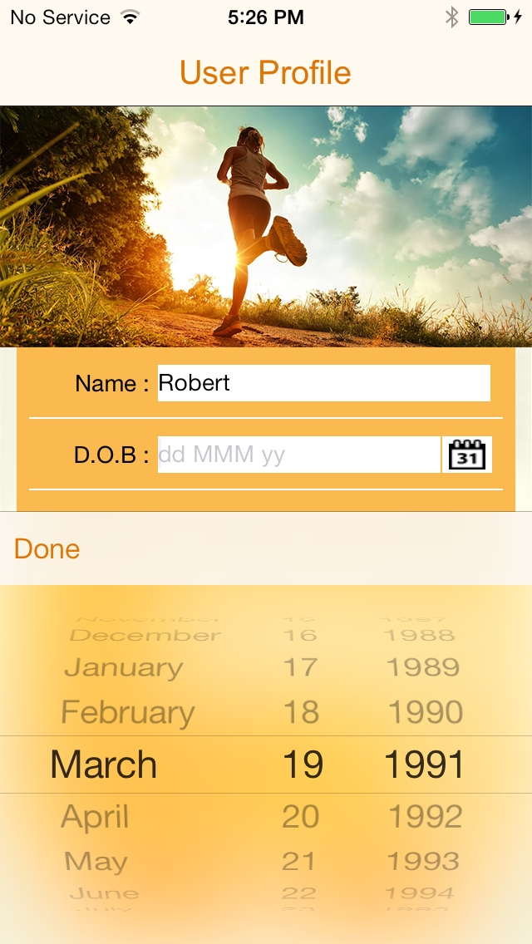
Edit User Profile 3

Slide 14
Edit User Profile 4

Slide 15
Use cases
User Profile
Connection Manager
Scan
Connect
Disconnect
Workout Goals
Workout
Workout Report
Statistics
HR Monitor
Workout Reminder
Reset All

Slide 16
Scan devices

Slide 17
Scanning 1

Slide 18
Scanning 2

Slide 19
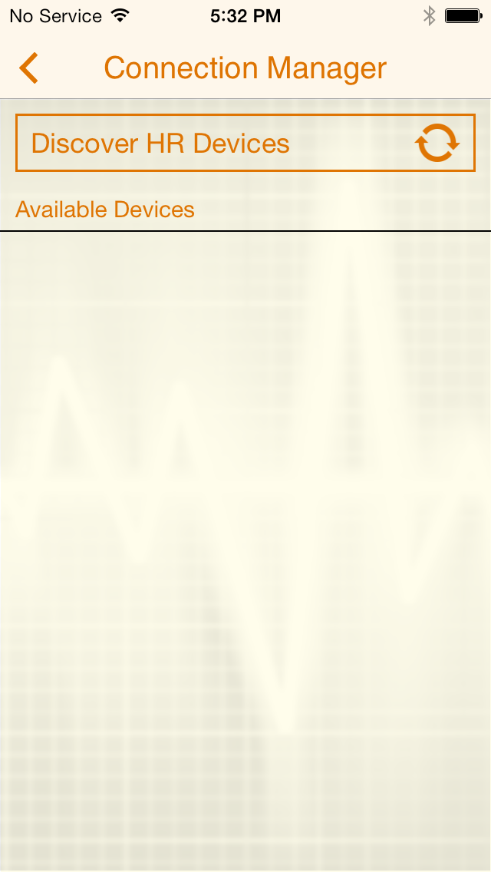
Scanning 3

Slide 20
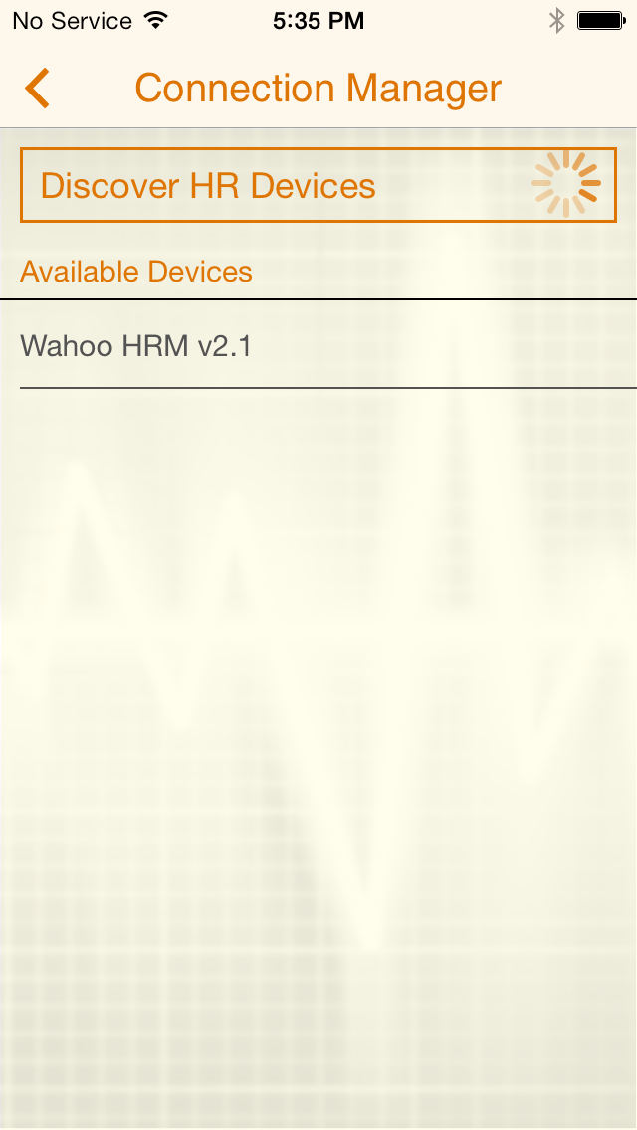
Scanning 4

Slide 21
Connect device

Slide 22
Connect 1

Slide 23
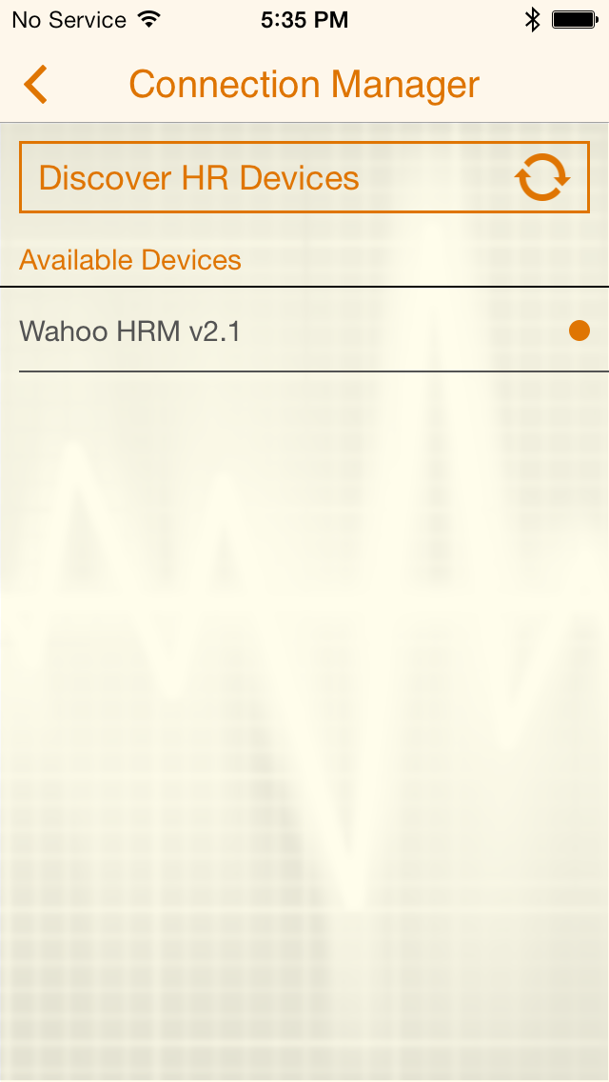
Connect 2

Slide 24
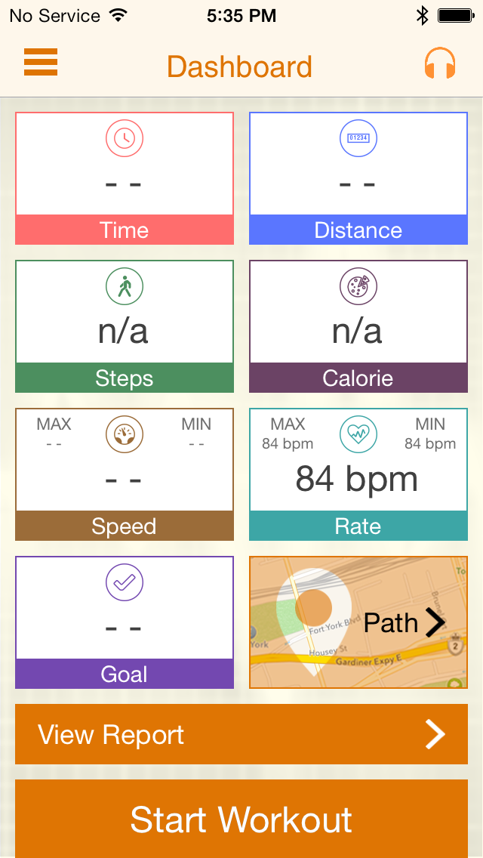
Connect 3

Slide 25
Disconnect device

Slide 26
Disconnect 1

Slide 27
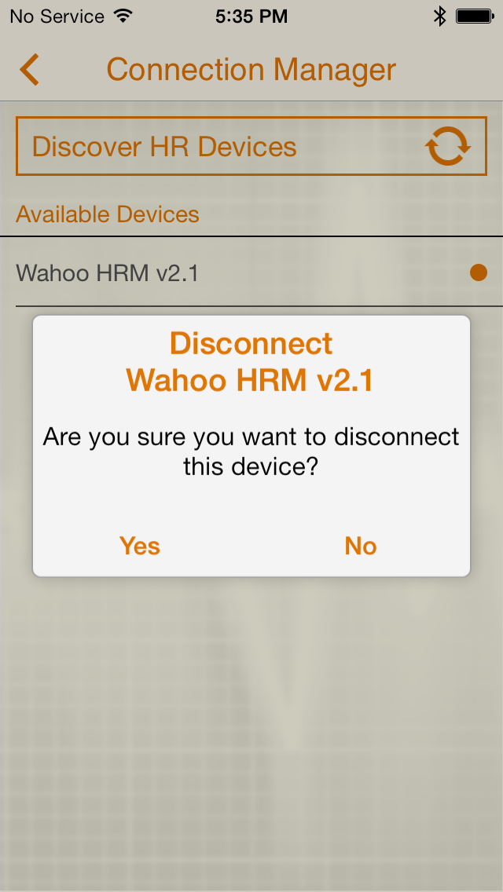
Disconnect 2

Slide 28
Use cases
User Profile
Connection Manager
Workout Goals
Set Workout Goal
Enable Workout Goal
Disable Workout Goal
Workout
Workout Report
Statistics
HR Monitor
Workout Reminder
Reset All

Slide 29
Set wo goal

Slide 30
Set WO goal 1

Slide 31
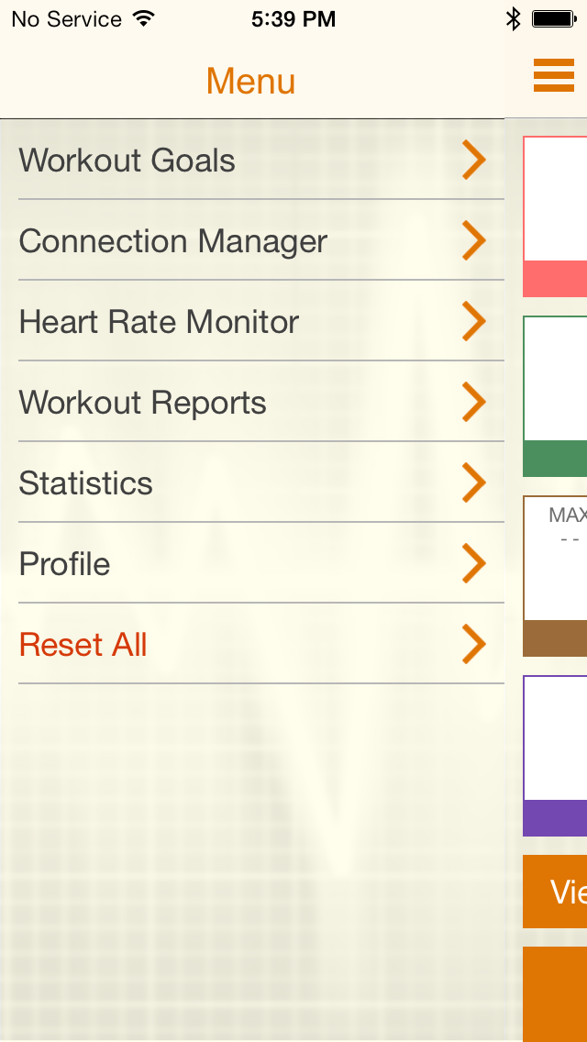
Set WO goal 2

Slide 32
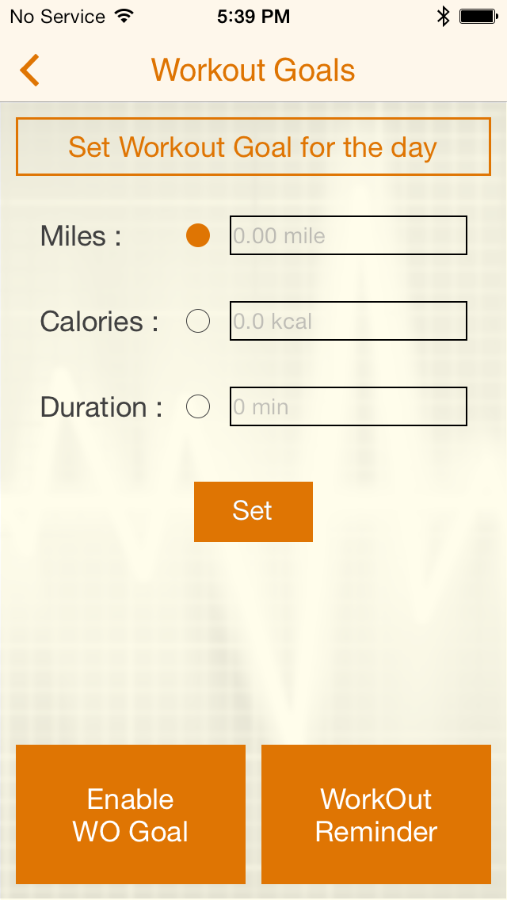
Set WO goal 3

Slide 33
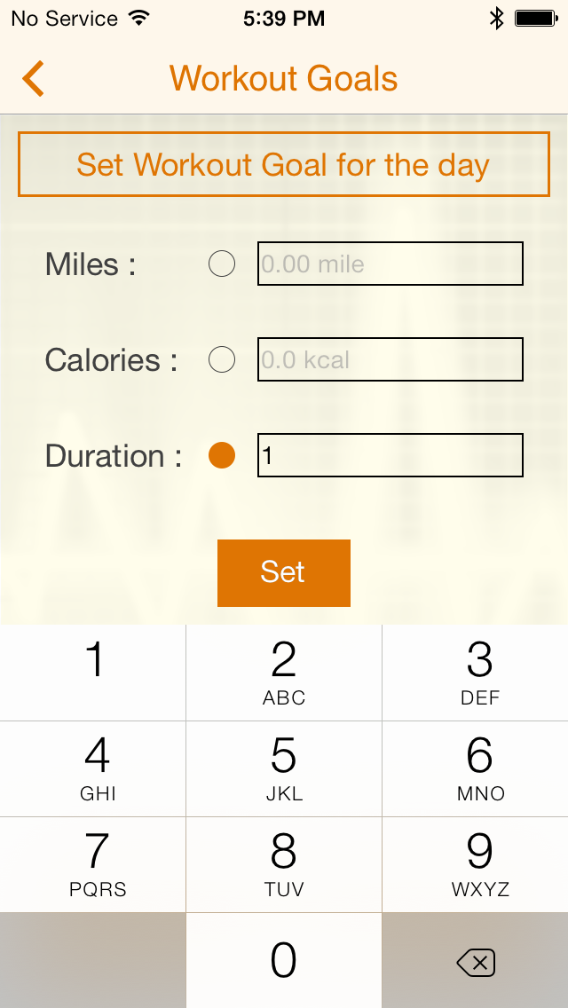
Set WO goal 4

Slide 34
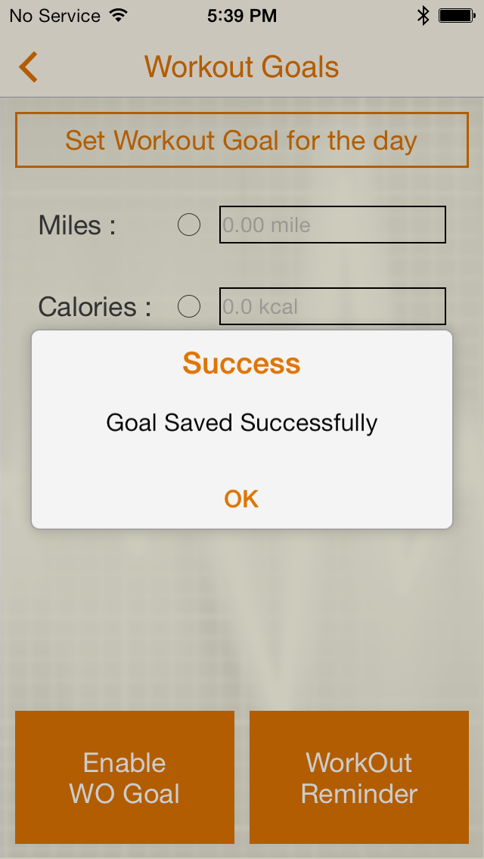
Set WO goal 5

Slide 35
Enable/disable wo goal

Slide 36
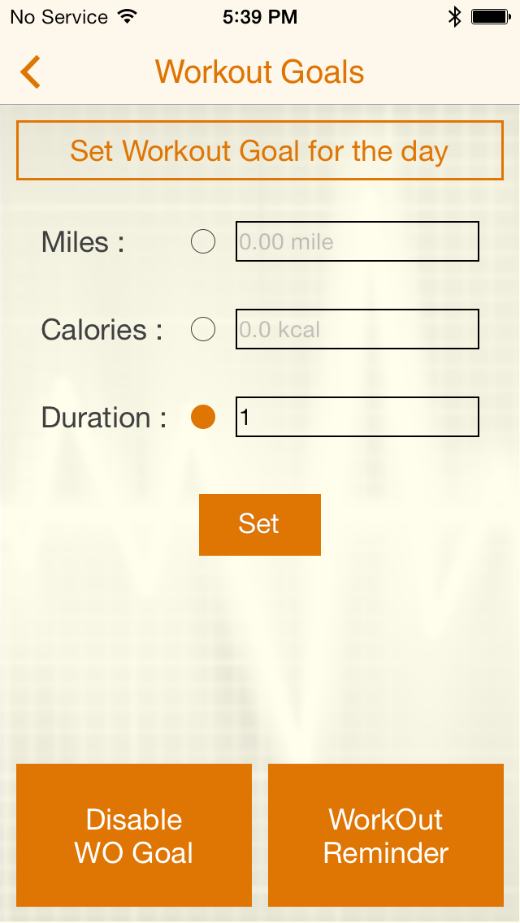
Enable / Disable WO goal

Slide 37
Use cases
User Profile
Connection Manager
Workout Goals
Workout
Enable Location Service
Workout without Goal
Workout with Goal
Music player
Voice Assistance
Workout Path
Workout Report
Statistics
HR Monitor
Workout Reminder
Reset All

Slide 38
Enable location service

Slide 39
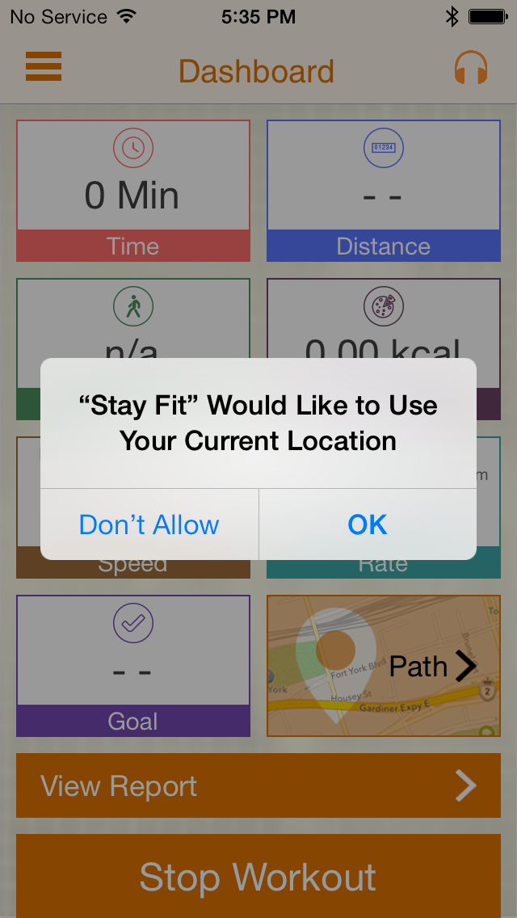
Enable Location Service 1

Slide 40
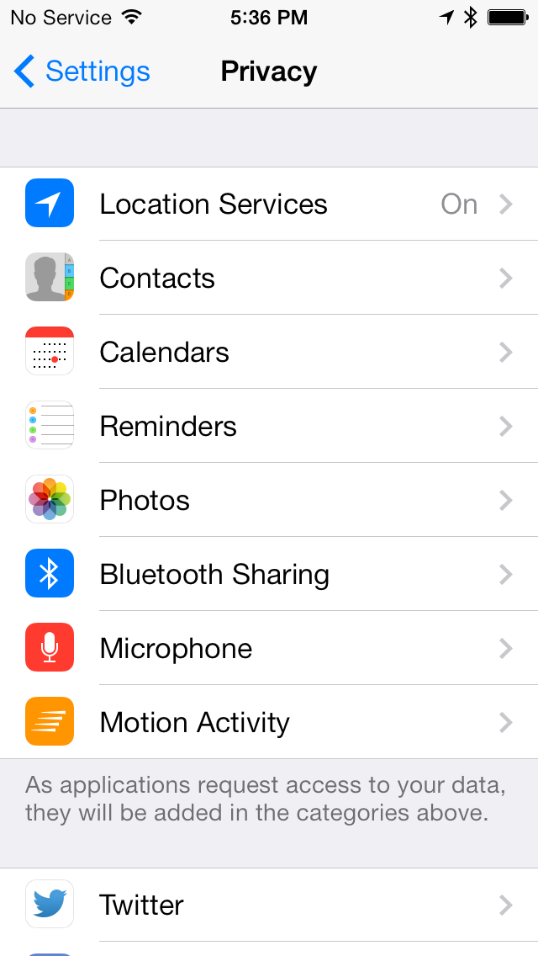
Enable Location Service 2

Slide 41
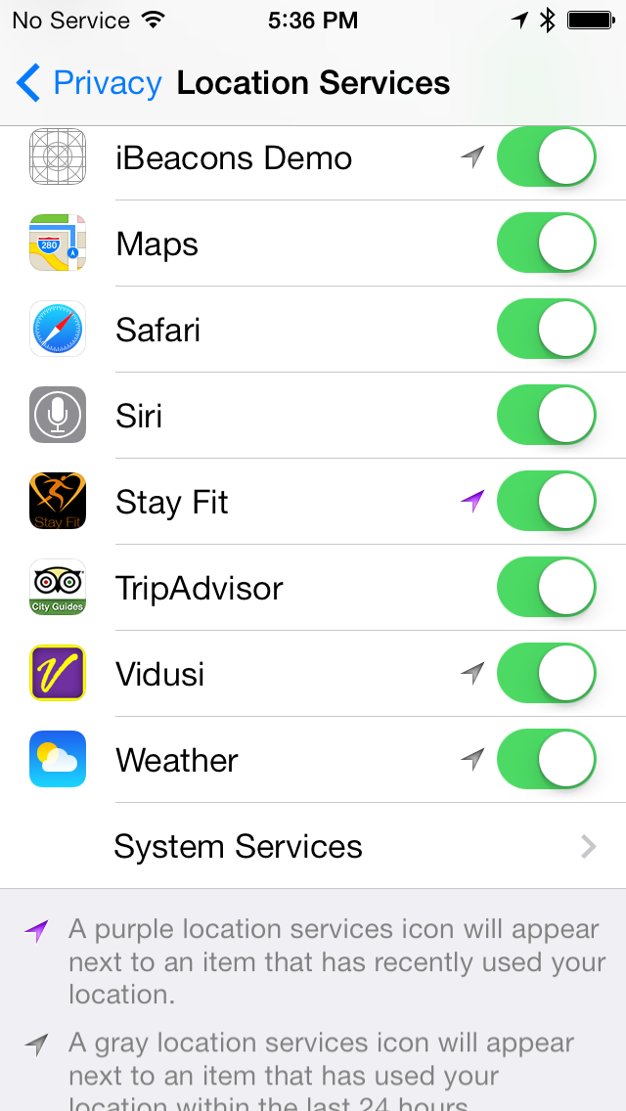
Enable Location Service 3

Slide 42
Workout With goal

Slide 43
Workout With Goal 1

Slide 44
Workout With Goal 2

Slide 45
Workout With Goal 3

Slide 46
Workout With Goal 4

Slide 47
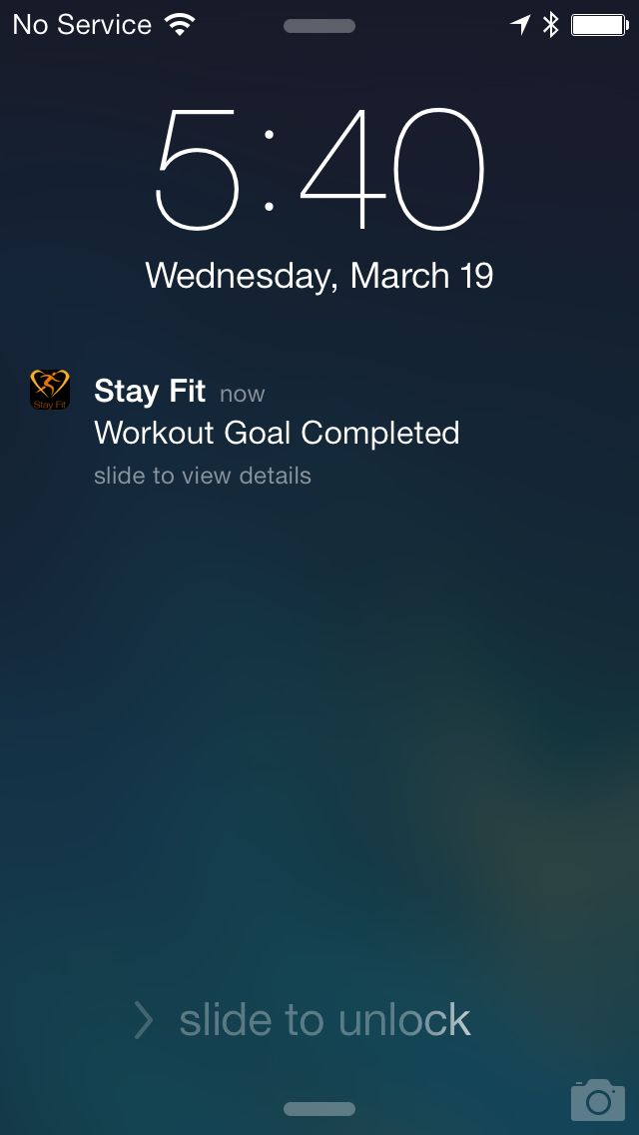
Workout With Goal 5

Slide 48
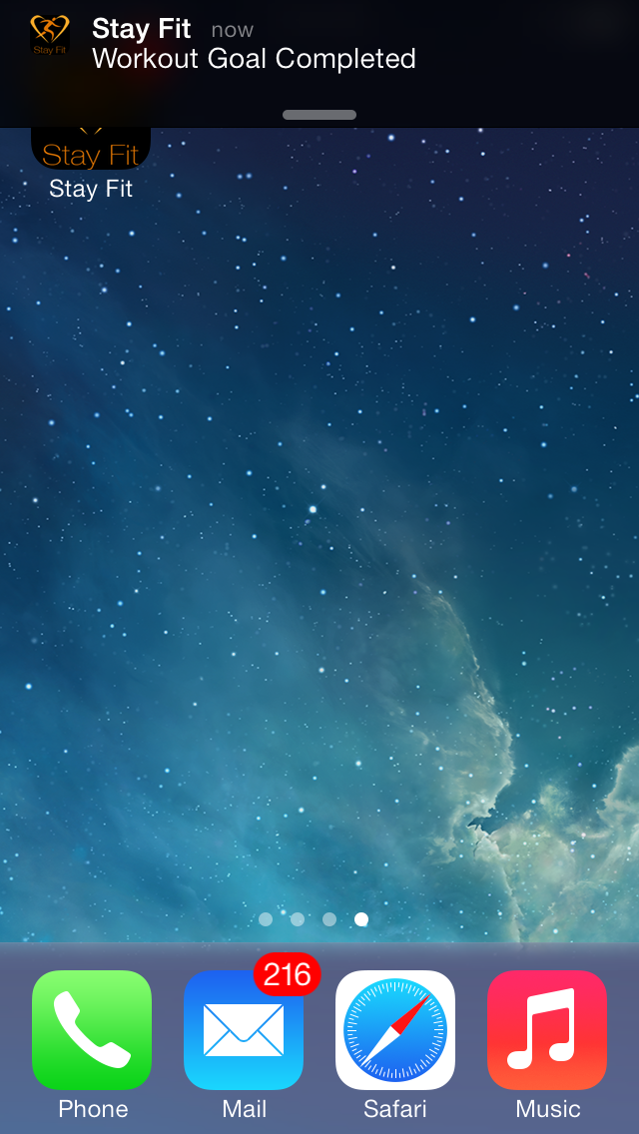
Workout With Goal 6

Slide 49
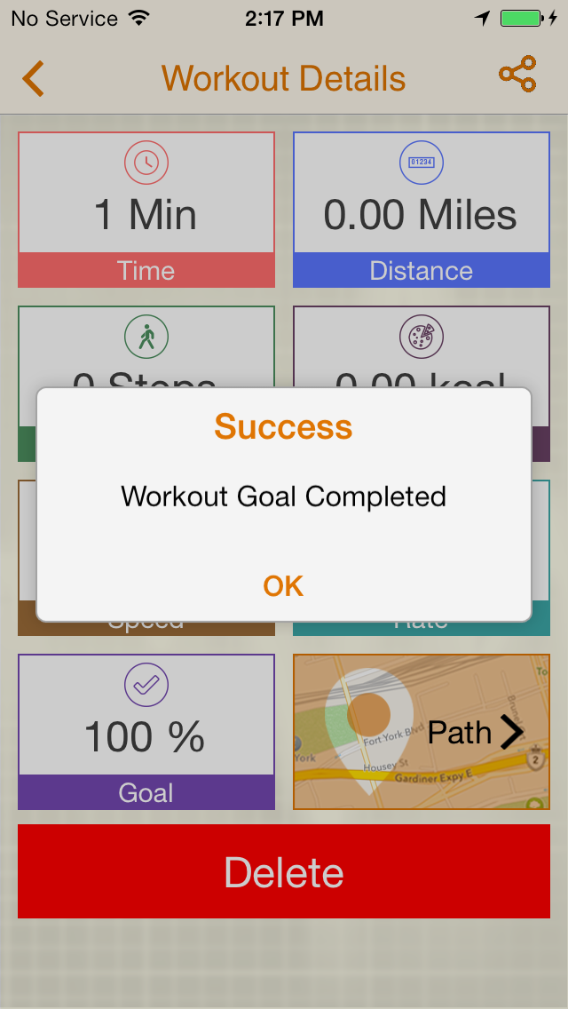
Workout With Goal 8

Slide 50
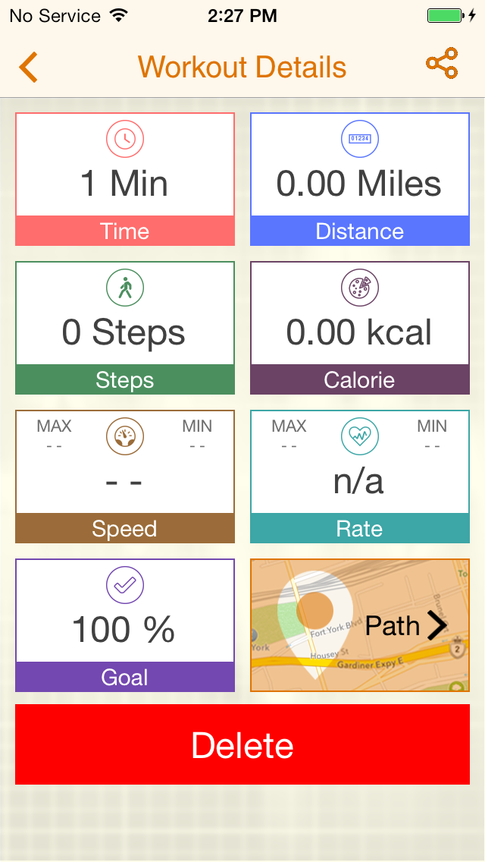
Workout With Goal 9

Slide 51
Music player

Slide 52
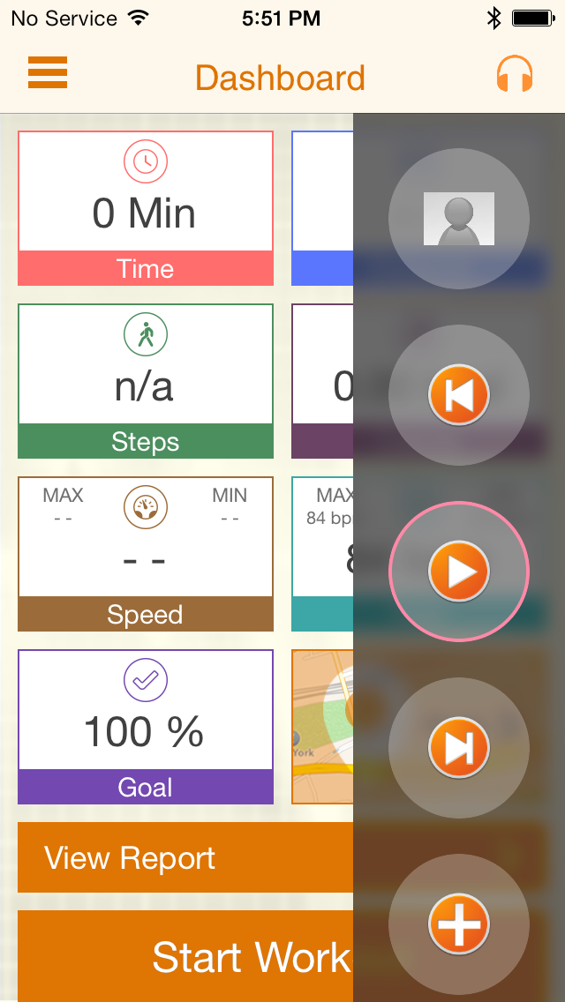
Music Player 1

Slide 53
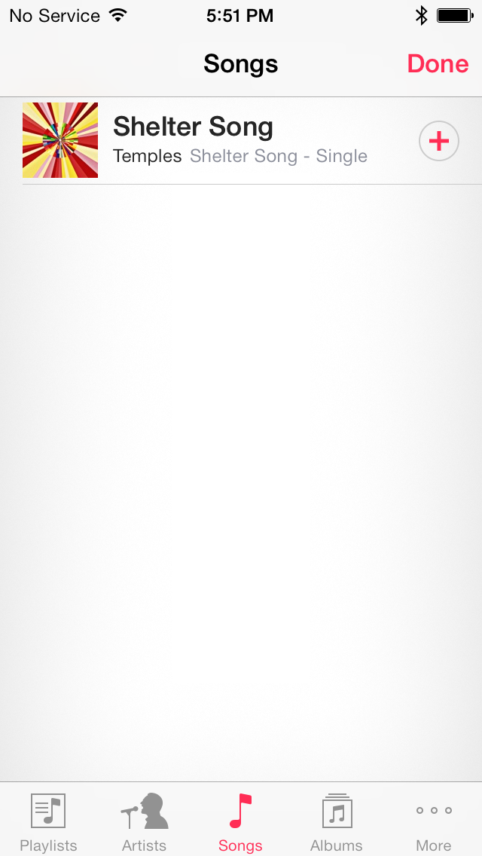
Music Player 2

Slide 54

Music Player 3

Slide 55
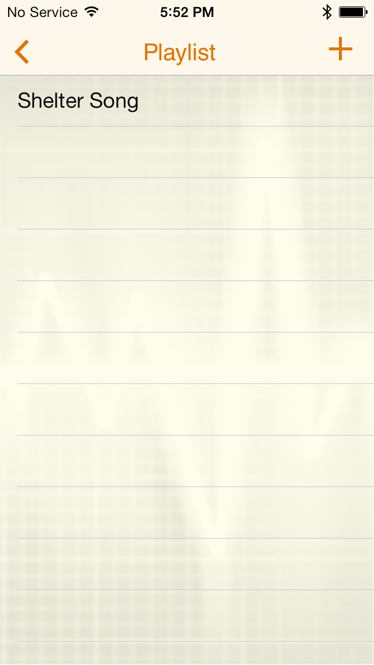
Music Player 4

Slide 56
Voice assistance

Slide 57
Voice feedback events
20% goal completion
100% goal completion
0.5 miles covered
5 minutes elapsed
0.05 kcal burn

Slide 58
Enable/ Disable Voice Assistance 1

Slide 59
Enable/ Disable Voice Assistance 2

Slide 60
Enable/ Disable Voice Assistance 3

Slide 61
Path on map

Slide 62
Path on Map 1

Slide 63
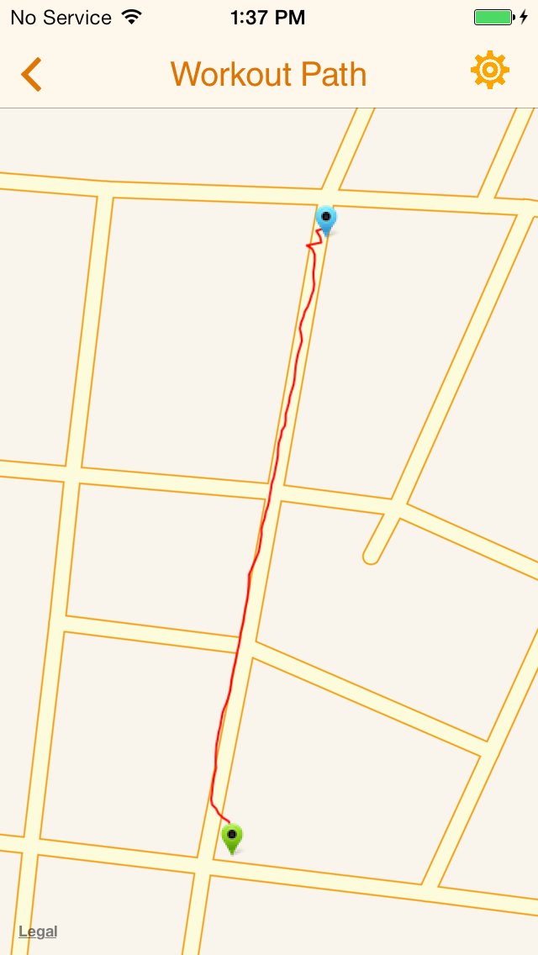
Path on Map 2

Slide 64
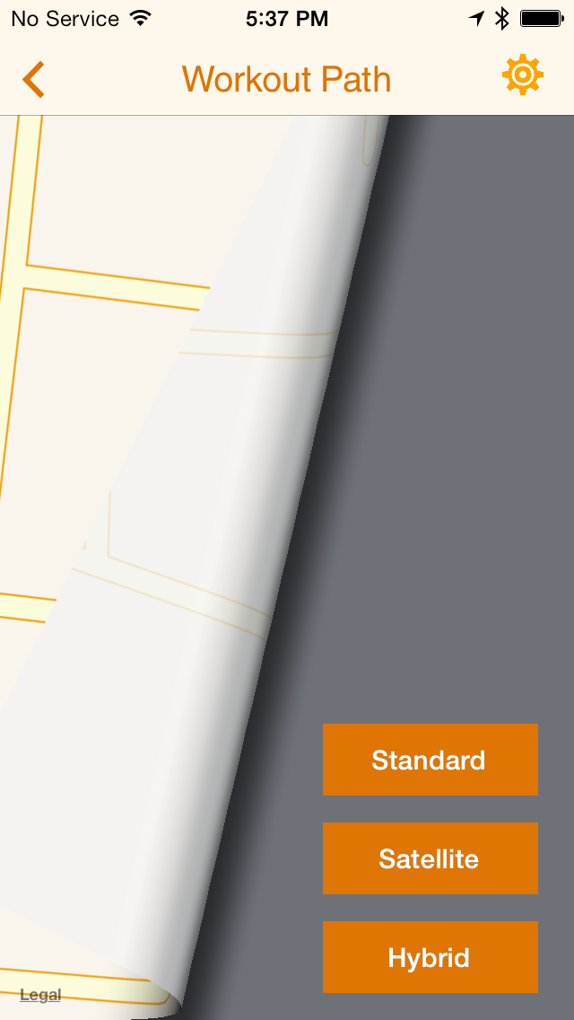
Path on Map 3

Slide 65
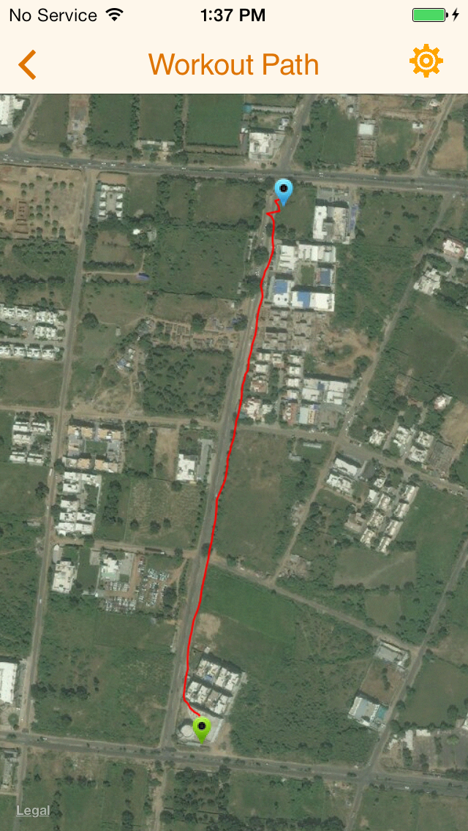
Path on Map 4

Slide 66
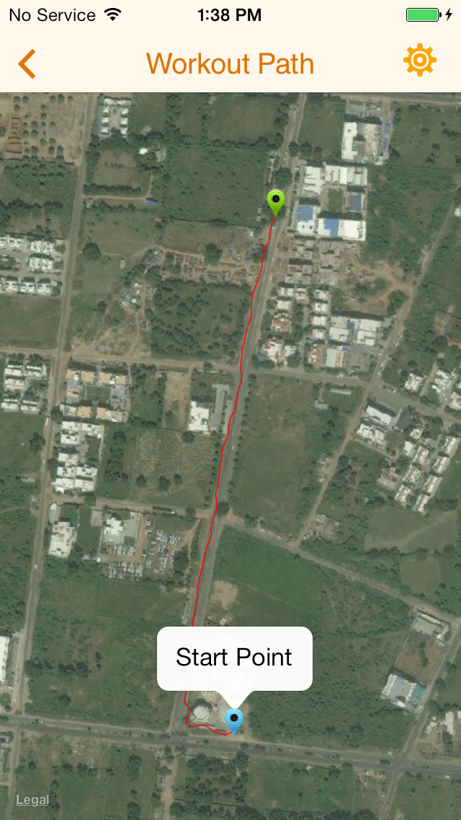
Path on Map 5

Slide 67
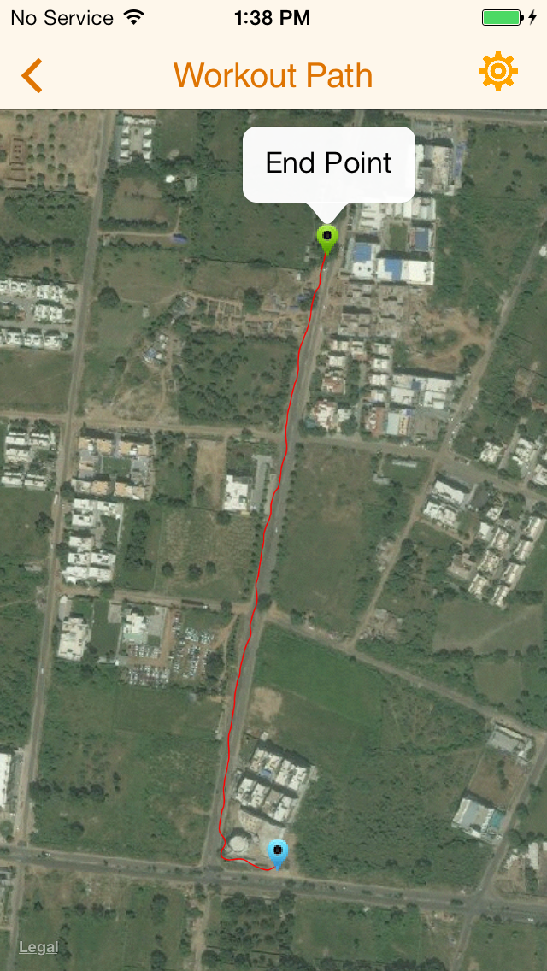
Path on Map 6

Slide 68
Use cases
User Profile
Connection Manager
Workout Goals
Workout
Workout Report
Today’s Workouts
All Workouts
Social Network Sharing
Statistics
HR Monitor
Workout Reminder
Reset All

Slide 69
Today’s workouts

Slide 70
Today’s Workout 1

Slide 71
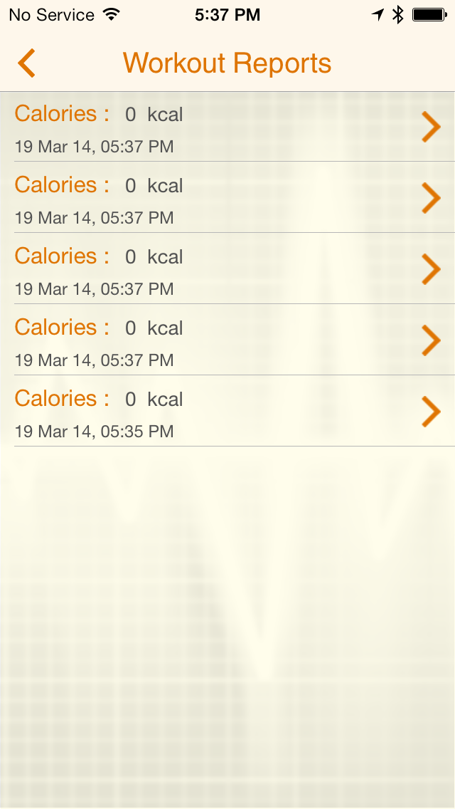
Today’s Workout 2

Slide 72
Today’s Workout 3

Slide 73
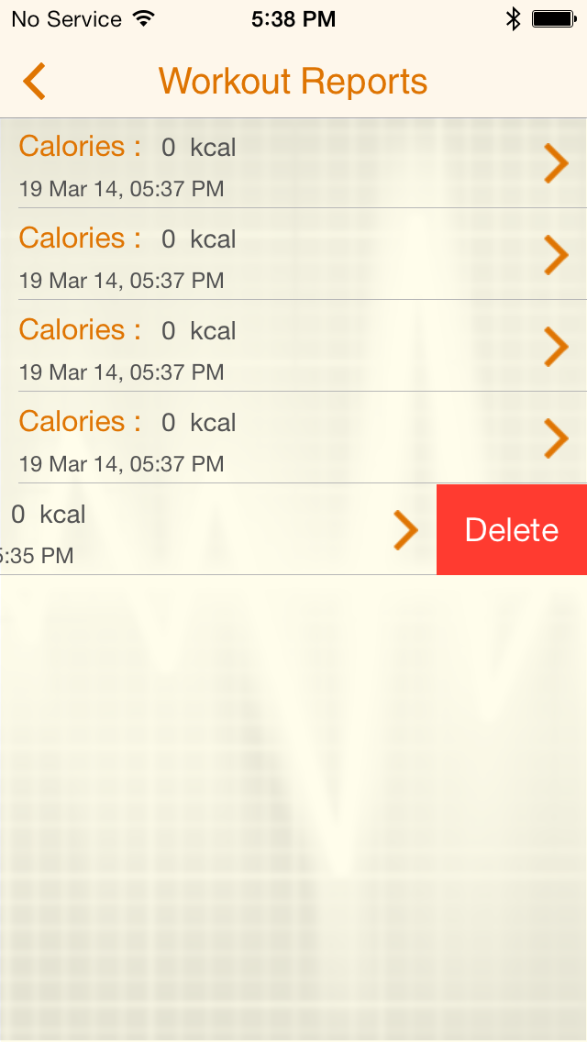
Today’s Workout 4

Slide 74
All Workouts

Slide 75
All Workouts 1

Slide 76
All Workouts 2

Slide 77
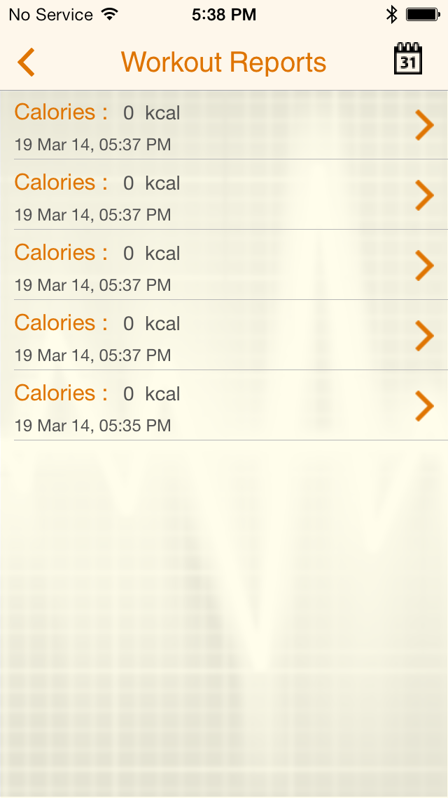
All Workouts 3

Slide 78
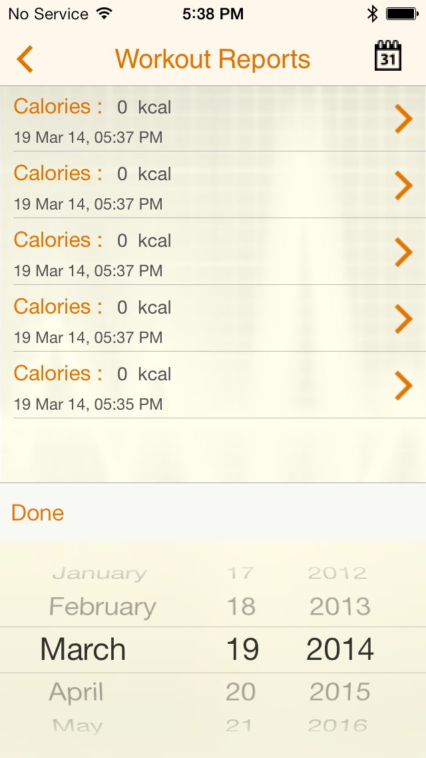
All Workouts 4

Slide 79
Social network Sharing

Slide 80
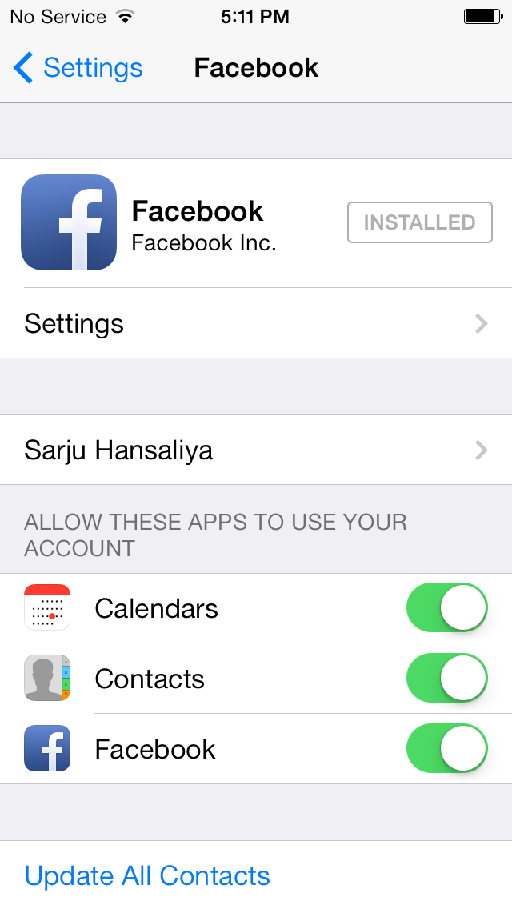
Social Network Sharing 1

Slide 81
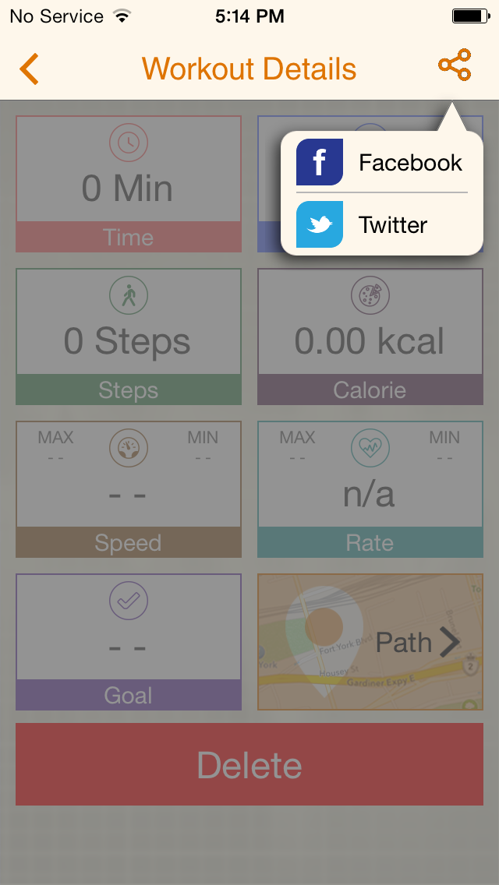
Social Network Sharing 2

Slide 82
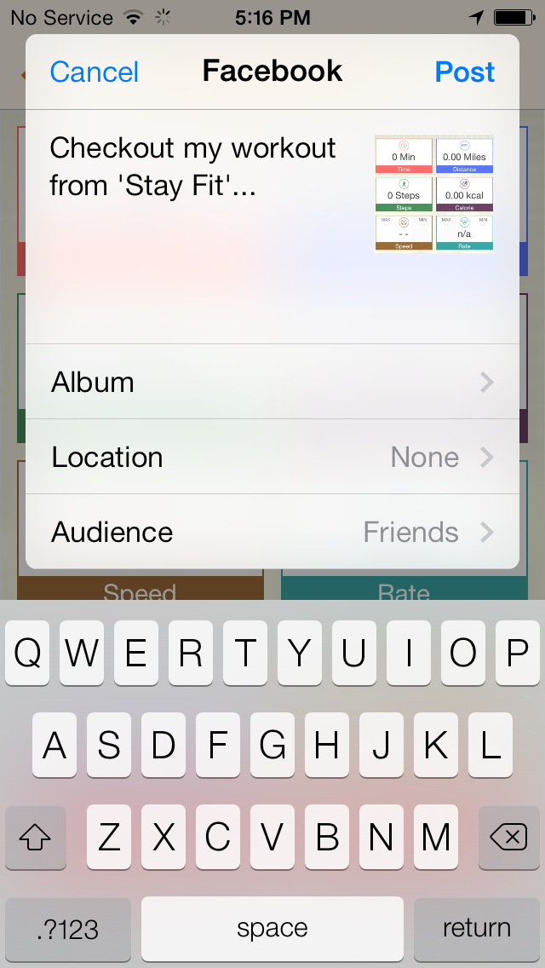
Social Network Sharing 3

Slide 84
Use cases
User Profile
Connection Manager
Workout Goals
Workout
Workout Report
Statistics
Social Network Sharing
HR Monitor
Workout Reminder
Reset All

Slide 85
Statistics 1

Slide 86
Statistics 2

Slide 87
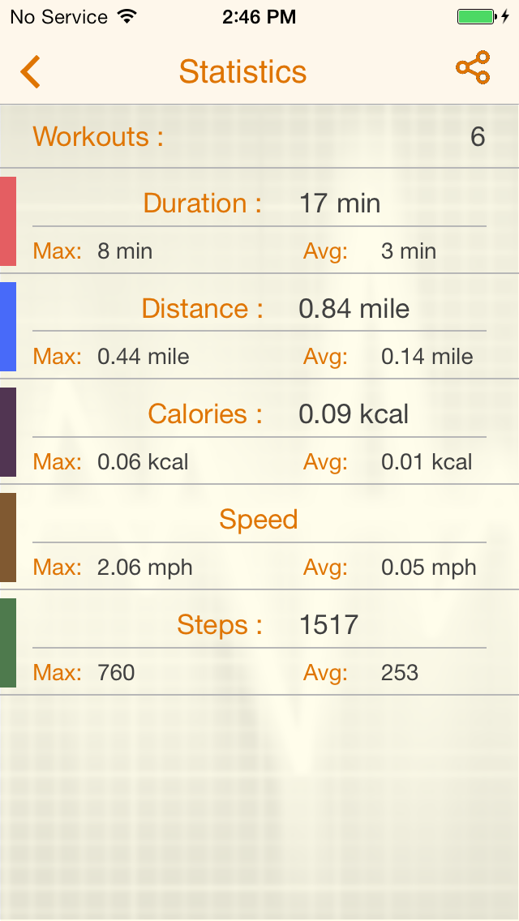
Statistics 3

Slide 88
Social network Sharing

Slide 89
Social Network Sharing 1

Slide 90
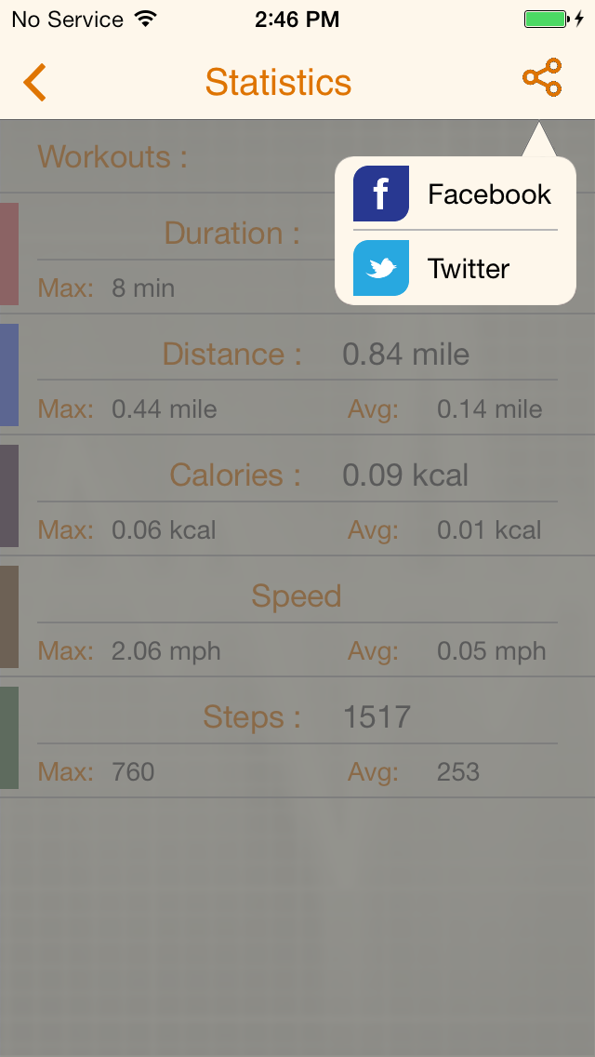
Social Network Sharing 2

Slide 91
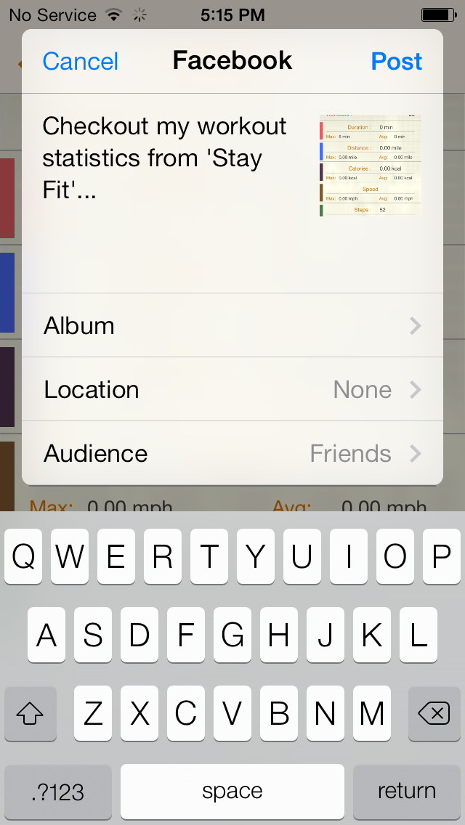
Social Network Sharing 3

Slide 92
Use cases
User Profile
Connection Manager
Workout Goals
Workout
Workout Report
Statistics
HR Monitor
Enable/Disable
Graph
Units
Workout Reminder
Reset All

Slide 93
Enable/disable hr monitoring from user profile

Slide 94
Enable/Disable HR Monitoring 1

Slide 95
Enable/Disable HR Monitoring 2

Slide 96
Enable/Disable HR Monitoring 3

Slide 97
Enable/disable hr monitoring from HRM

Slide 98
Enable/Disable HR Monitoring 1

Slide 99
Enable/Disable HR Monitoring 2

Slide 100
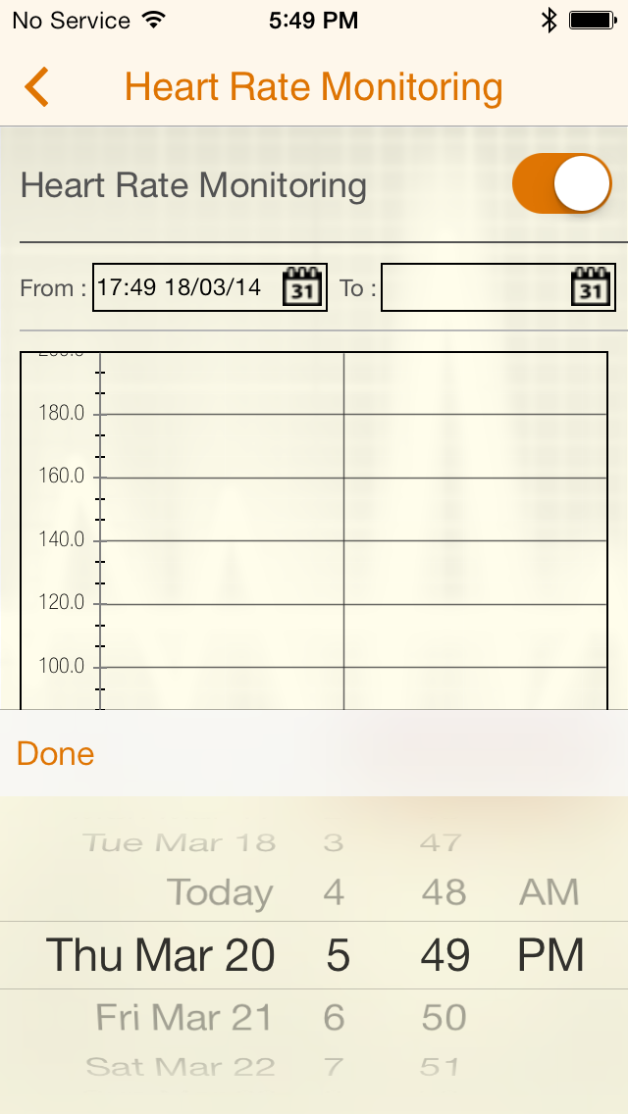
Enable/Disable HR Monitoring 3

Slide 101
HR plot

Slide 102
HR Plot 1

Slide 103
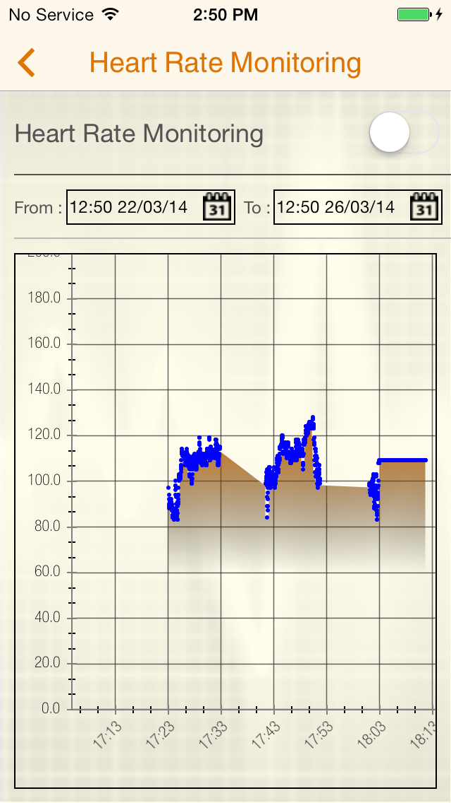
HR Plot 2

Slide 104
HR plot units

Slide 105
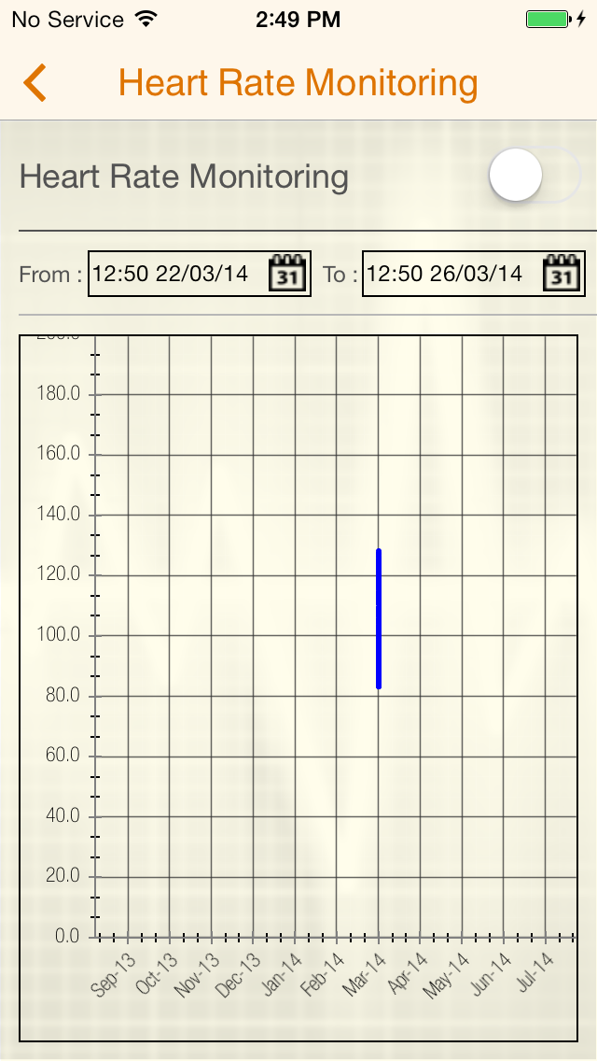
HR Plot Unit Month(MMM-yy)

Slide 106
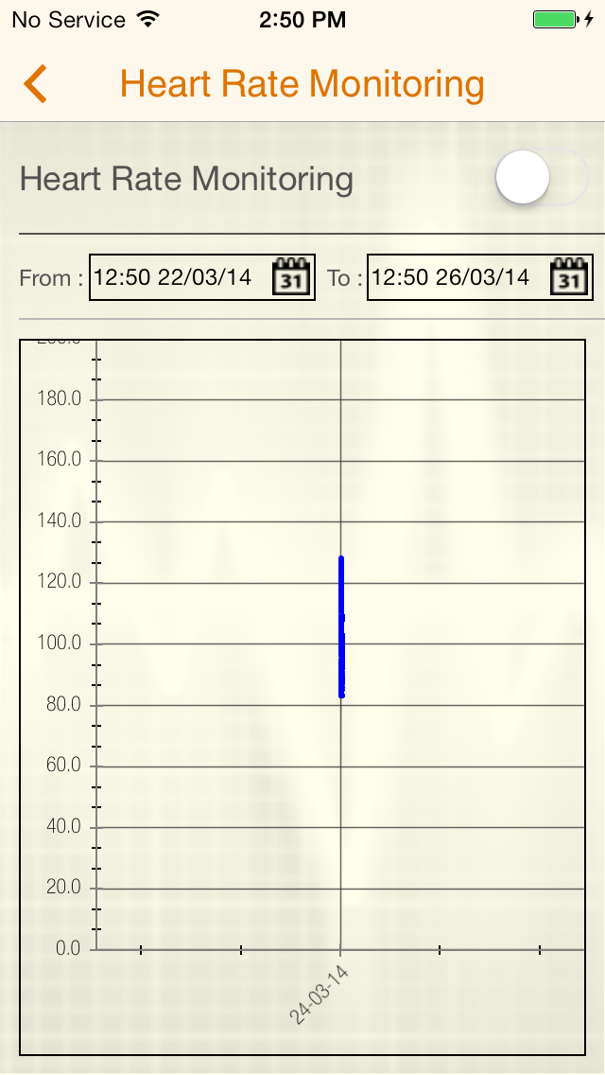
HR Plot Units Week(dd-MM-yy)

Slide 107
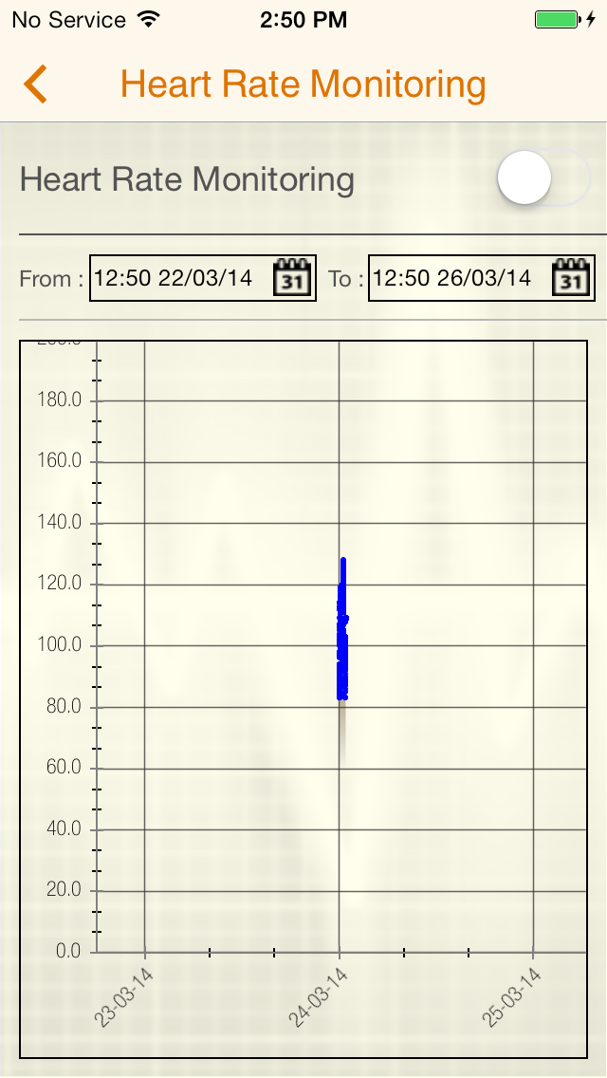
HR Plot Units Date(dd-MM-yy)

Slide 108
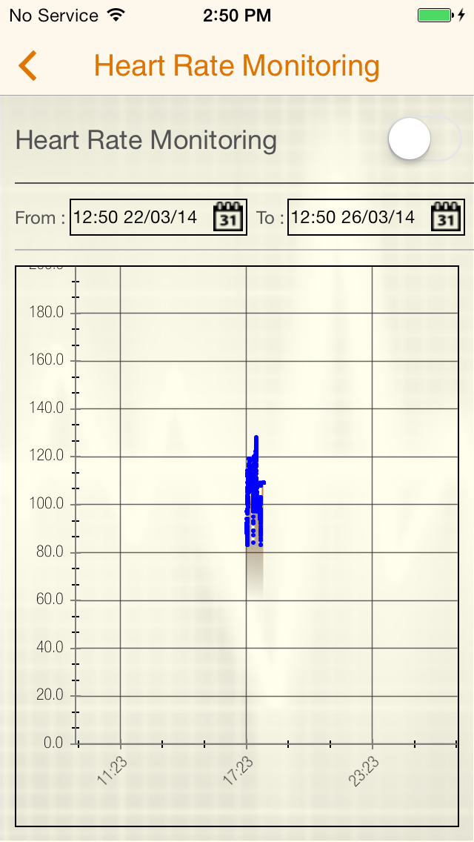
HR Plot Units 6 hours(hh:mm)

Slide 109
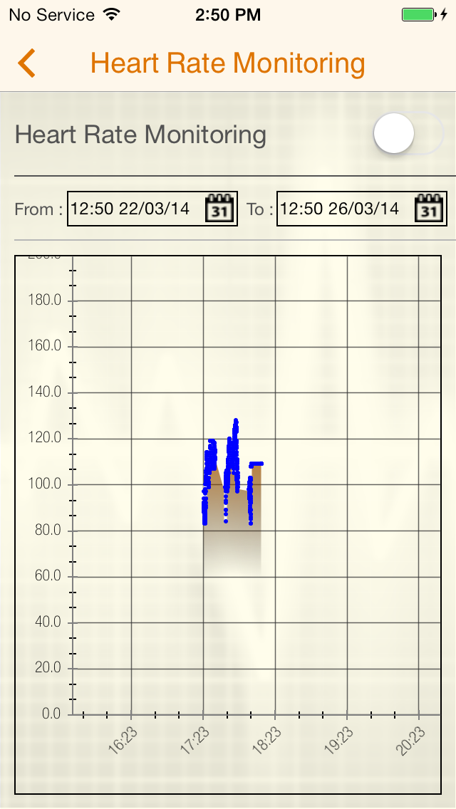
HR Plot Units 1 Hour (hh:mm)

Slide 110
HR Plot Units 10 min(hh:mm)

Slide 111
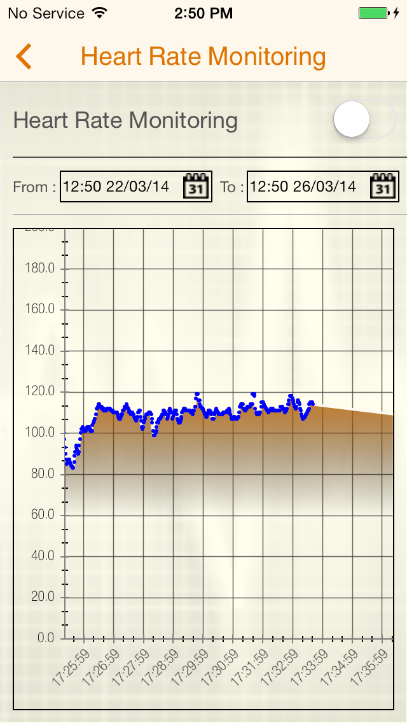
HR Plot Units 1 min (hh:mm:ss)

Slide 112
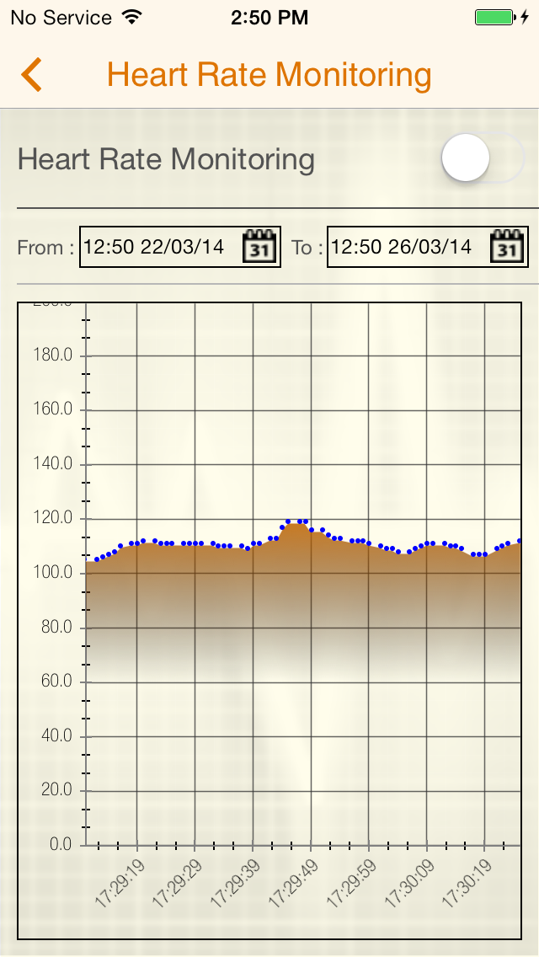
HR Plot Units 10 Seconds (hh:mm:ss)

Slide 113
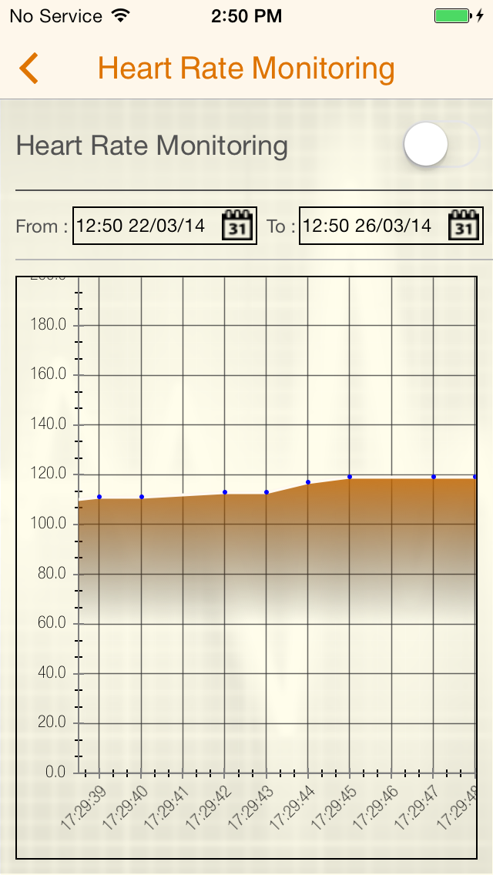
HR Plot Units 1 Second (hh:mm:ss)

Slide 114

HR Plot HR Value

Slide 115
Use cases
User Profile
Connection Manager
Workout Goals
Workout
Workout Report
Statistics
HR Monitor
Workout Reminder
Add New
Edit
Delete
Reset All

Slide 116
Add new reminder

Slide 117

Add New Reminder 1

Slide 118

Add New Reminder 2

Slide 119

Add New Reminder 3

Slide 120

Add New Reminder 4

Slide 121

Add New Reminder 5

Slide 122

Add New Reminder 6

Slide 123

Add New Reminder 7

Slide 124

Add New Reminder 8

Slide 125

Add New Reminder 9

Slide 126

Add New Reminder 10

Slide 127

Add New Reminder 11

Slide 128

Add New Reminder 12

Slide 129

Add New Reminder 13

Slide 130

Add New Reminder 14

Slide 131

Add New Reminder 15

Slide 132

Add New Reminder 16

Slide 133
Edit reminder

Slide 134
Edit Reminder 1

Slide 135

Edit Reminder 2

Slide 136

Edit Reminder 3

Slide 137

Edit Reminder 4

Slide 138

Edit Reminder 5

Slide 139

Edit Reminder 6

Slide 140

Edit Reminder 7

Slide 141
Delete reminder

Slide 142
Delete Reminder 1

Slide 143

Delete Reminder 2

Slide 144

Delete Reminder 3

Slide 145
Use cases
User Profile
Connection Manager
Workout Goals
Workout
Workout Report
Statistics
HR Monitor
Workout Reminder
Reset All

Slide 146
Reset all

Slide 147
Reset 1

Slide 148
Reset 2

Slide 149

Reset 3

Slide 150

Reset 4

Slide 151

Reset 5

Slide 152
Reset 6

Slide 153
Limitations
Data Saved Locally
No Voice Assistance Preferences
No Cloud Sync

Slide 154
Future Extensions
Cloud Synchronization
Social Network Sync

Slide 155
Questions

Slide 156
Thanking you…

